Slide 1

AI Self‑Decomposing Polymers
Revolutionizing Sustainability

Slide 2
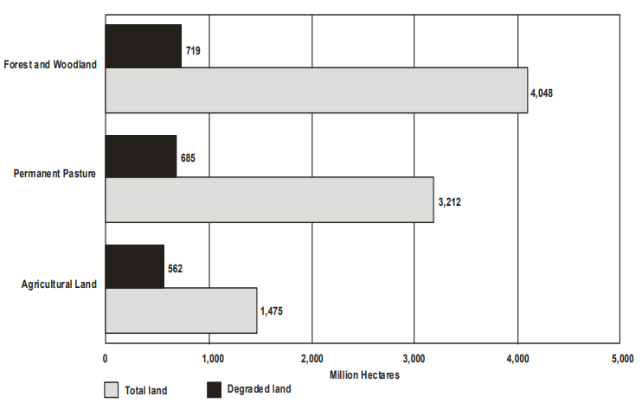
The Problem: Persistent Environmental Pollution
Current biodegradable materials require specific conditions (e.g., industrial composting) to break down.
Non-biodegradable chemicals/polymers persist in the environment, causing pollution.
Overuse of pesticides/insecticides in regions like Punjab/Haryana has degraded soil fertility.
Graph illustrating degradation of land in Punjab/Haryana state province, study done by GLASOD (Global Assessment of Human-induced Soil Degradation)
Note: Figures are cumulative

Slide 3

Punjab's Soil Crisis: Chemical Overuse
Punjab faces a severe soil crisis due to chemical overuse. This threatens its agricultural sustainability.
Fertilizer Consumption: 247.6 kg/ha (2023) vs. national avg. 139.8 kg/ha.
Pesticide Use: 3,982 MT annually (3rd highest nationally).
Yield Decline: Wheat productivity fell 17% (2017-2022) despite more fertilizers.

Slide 4
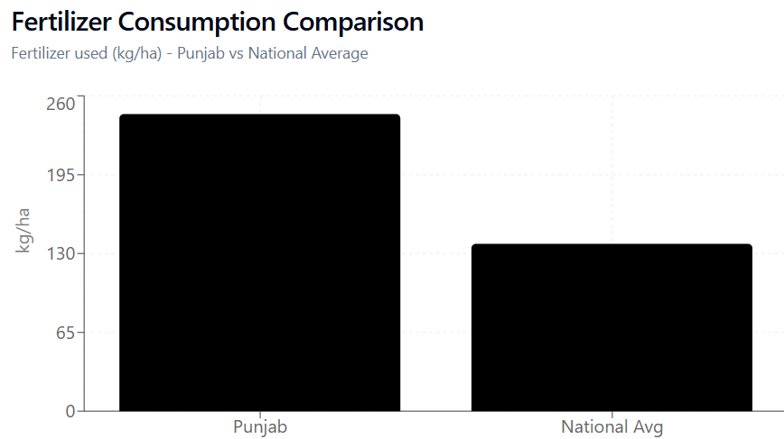
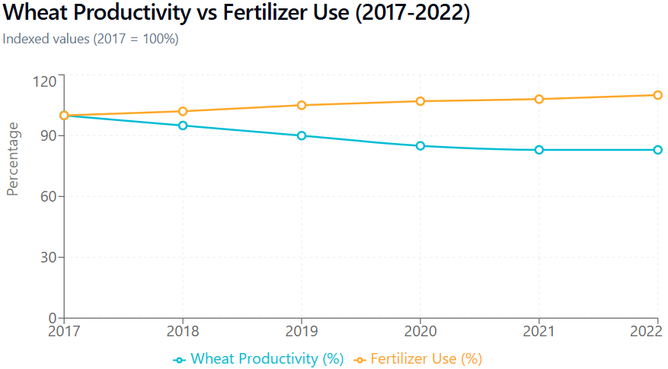
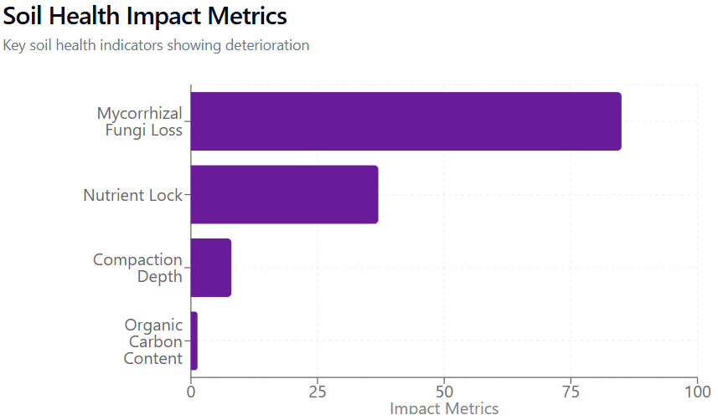
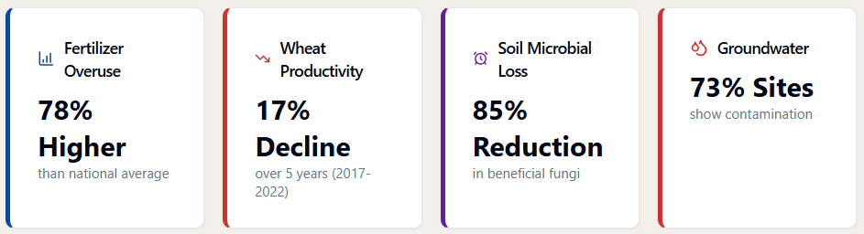
Punjab / Haryana Soil Crisis

Slide 5
Market Gap
Traditional Biodegradables | AI-Designed Polymers
Require 50-60°C & 60-70% humidity | Function across diverse conditions
Take 6-24 months for full breakdown | Immediate activation via triggers
Leave microplastic residues | Complete molecular disassembly
Limited to industrial compost facilities | Field-deployable in natural environments

Slide 6

AI-Designed Molecular Kill Switches
Mechanism & Innovation: Machine learning optimizes molecular structures. It uses environmental triggers for targeted disassembly. These triggers include pH, temperature, and microbes.
Example: Harvard's "spider" molecule dismantles colloidal cages on command. This is achieved using differentiable MD simulations.
Key advantage: Programmable decomposition avoids persistent contamination.

Slide 7
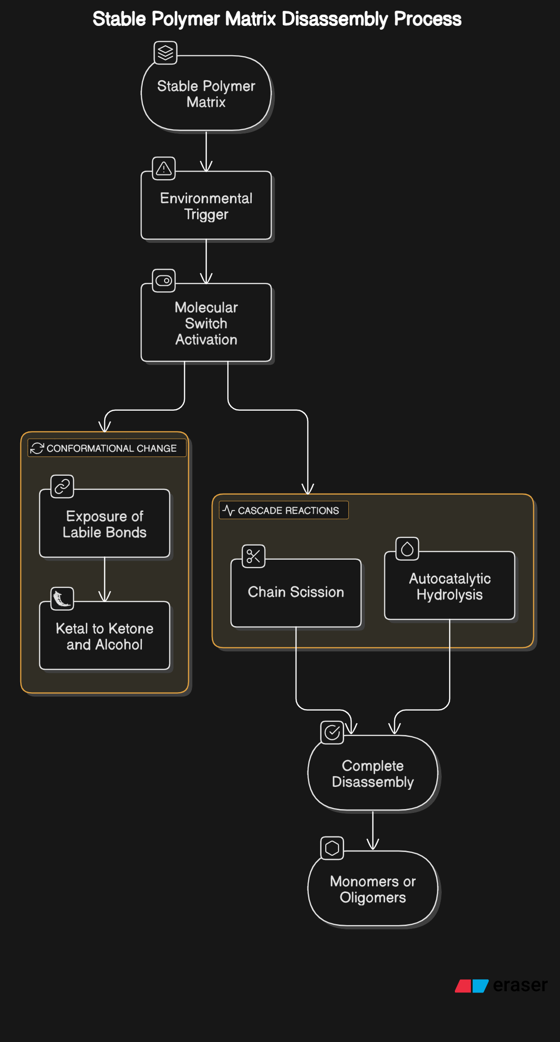
Our Solution: Self Decomposing
Chemicals
AI designs chemicals/polymers with embedded "molecular kill switches."
These switches activate decomposition based on environmental triggers (e.g., pH, temperature, microbial presence).

Slide 8
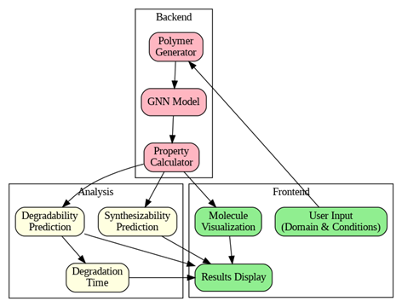
Workflow Diagram

Slide 9



AI Chemical Design for Agriculture
Microbe-Activated Pesticides
pH-Responsive Fertilizer Coatings
Temperature-Triggered Bioplastics
Decompose when soil biodiversity thresholds are met. Prevent chemical persistence in degraded soils.
Release nutrients only at optimal soil acidity (pH 6-7). Reduce urea waste from 40% to <10%.
Breakdown initiates at 35°C (ambient Punjab summer temps). Eliminate stubble burning through biodegradable crop covers.

Slide 10
Why our Solution Matters
🌍 Environmental Remediation | 🌾 Agricultural Revitalization | ♻️ Scalable Sustainability
- Reduces pesticide residues | - Restores soil health | - Decomposes at 35°C
- Eliminates microplastics | - Maintains high yields | Aligns with UN SDGs(Sustainable Development Goals)
- Cuts embodied energy | - Saves farmers 28% costs | - $2.1B market potential

Slide 11
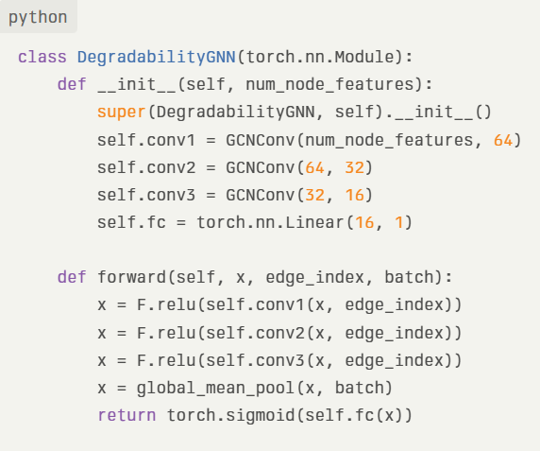
Graph Neural Network(GNNs)
Key Features
Purpose: Model to process and analyze data to generate Polymer
graphs and predict degradability scores for polymers based on
molecular graphs.
Architecture:
Input: Node features (atomic properties) and edge indices (bond connections).
Layers:
3 Graph Convolutional Layers (GCNConv).
Global Mean Pooling for graph-level representation.
Fully Connected Layer for final prediction.
Output: Represent Polymers and sigmoid activation to predict degradability score (0–1).

Slide 12
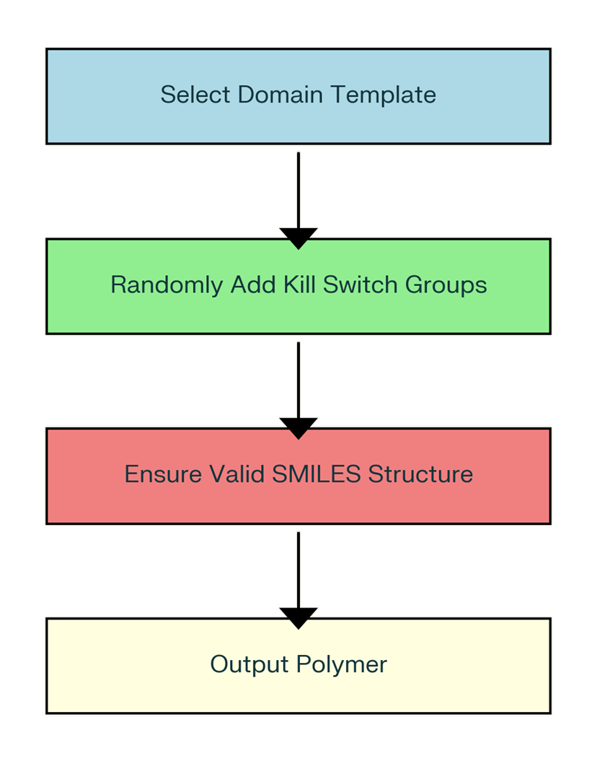
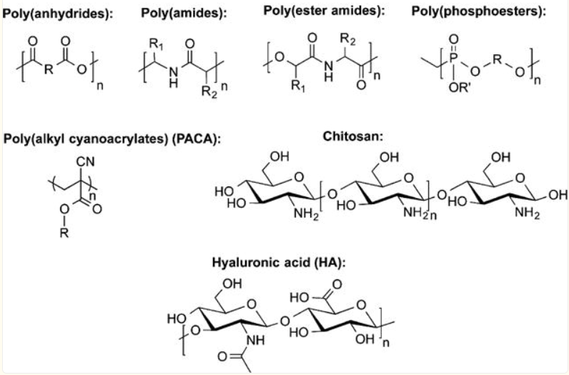

POLYMER Generation

Slide 13
Additional Features
Model predicts Degradability Score for each Polymer using SMARTS Patterns and adjusting it acc.
Systematic nomenclature generation based on functional groups and structure type.
Predicts the Synthetic Accessibility (SA) Score based on the number of fragments / bonds and structural complexity

Slide 14
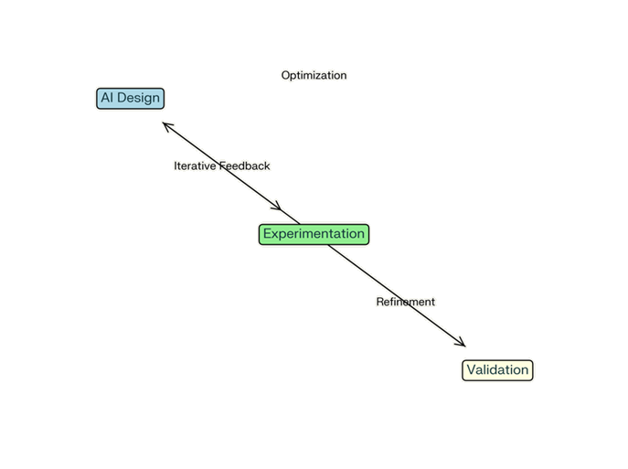
Challenges Faced & Lessons Learned
Challenges
Data Quality & Availability: 📊
Lack of standardized databases for sustainable materials.
Complexity of Chemical Systems: 🧪
Difficulty modelling intricate molecular interactions.
Computational Resources: 💻
High-performance computing demands increase costs.
Learnings
Collaborative Approach: 🤝
Interdisciplinary teamwork enhances reliability.
Improved Data Practices: 📂
Standardized datasets improve model accuracy.
Ethical Considerations: 🌱
Ensures sustainability without unintended harm.

Slide 15
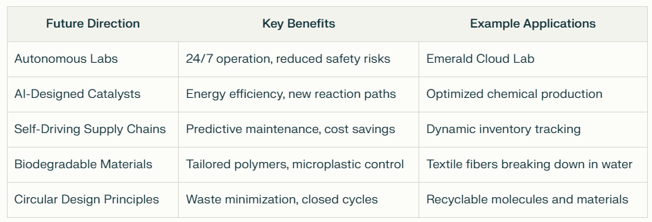
Future Directions

Slide 16

Join Us in Shaping a Sustainable Future
“Let’s make sustainability smarter!”

